Slide 1
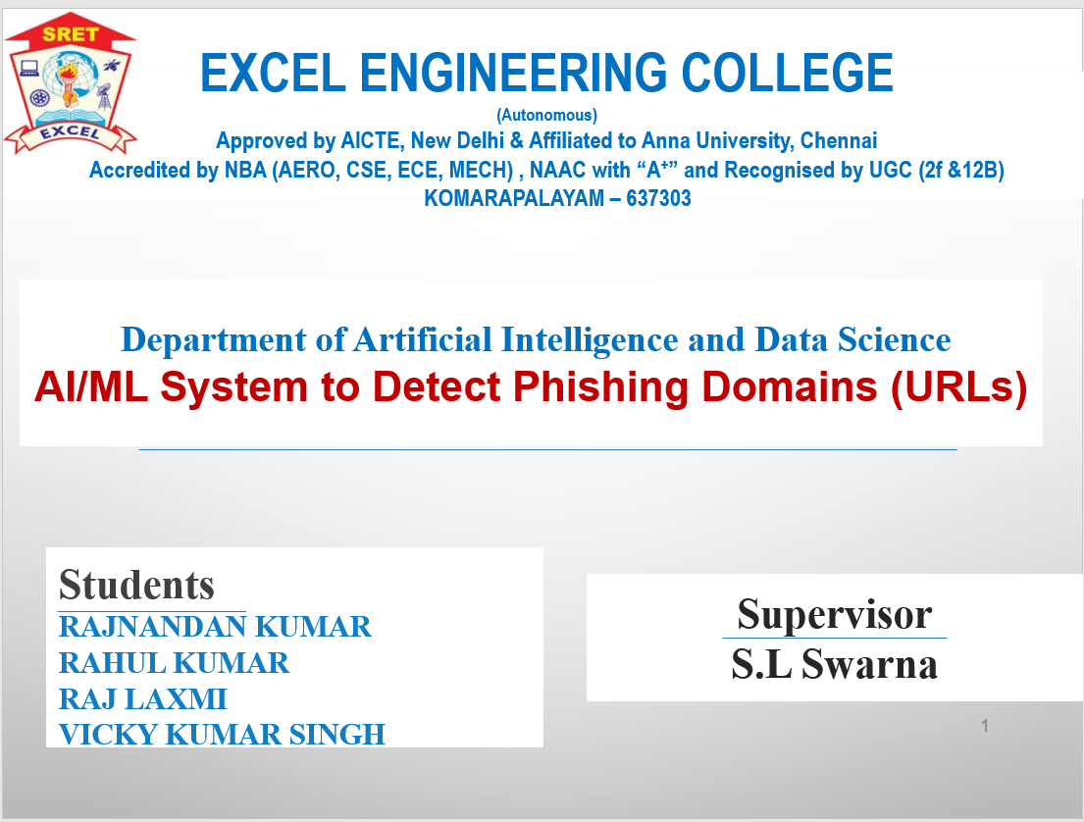

Slide 2

Presentation Outline
Objective
Introduction
Literature Survey
Existing System
Proposed System
Algorithms
Implementation & Result
Conclusion

Slide 3


Objective
1
Clear Goal
The objective is to develop and implement a machine learning system specifically designed to identify and categorize phishing URLs accurately and efficiently.
2
Enhanced Security
By achieving this goal, it will significantly enhance the security posture of individuals and organizations, reducing the risks associated with deceptive URLs.
3
Scalable Solution
The system aims to be scalable, capable of adapting to evolving cyber threats and maintaining robust protection against phishing attacks.

Slide 4

Introduction to Phishing URLs Detection
Phishing URL detection is a critical aspect of cybersecurity, aiming to identify and prevent deceptive web addresses used for malicious purposes. By leveraging machine learning algorithms, it becomes possible to recognize patterns and behaviors associated with phishing URLs and their features, enhancing the security and trustworthiness of online interactions.

Slide 5
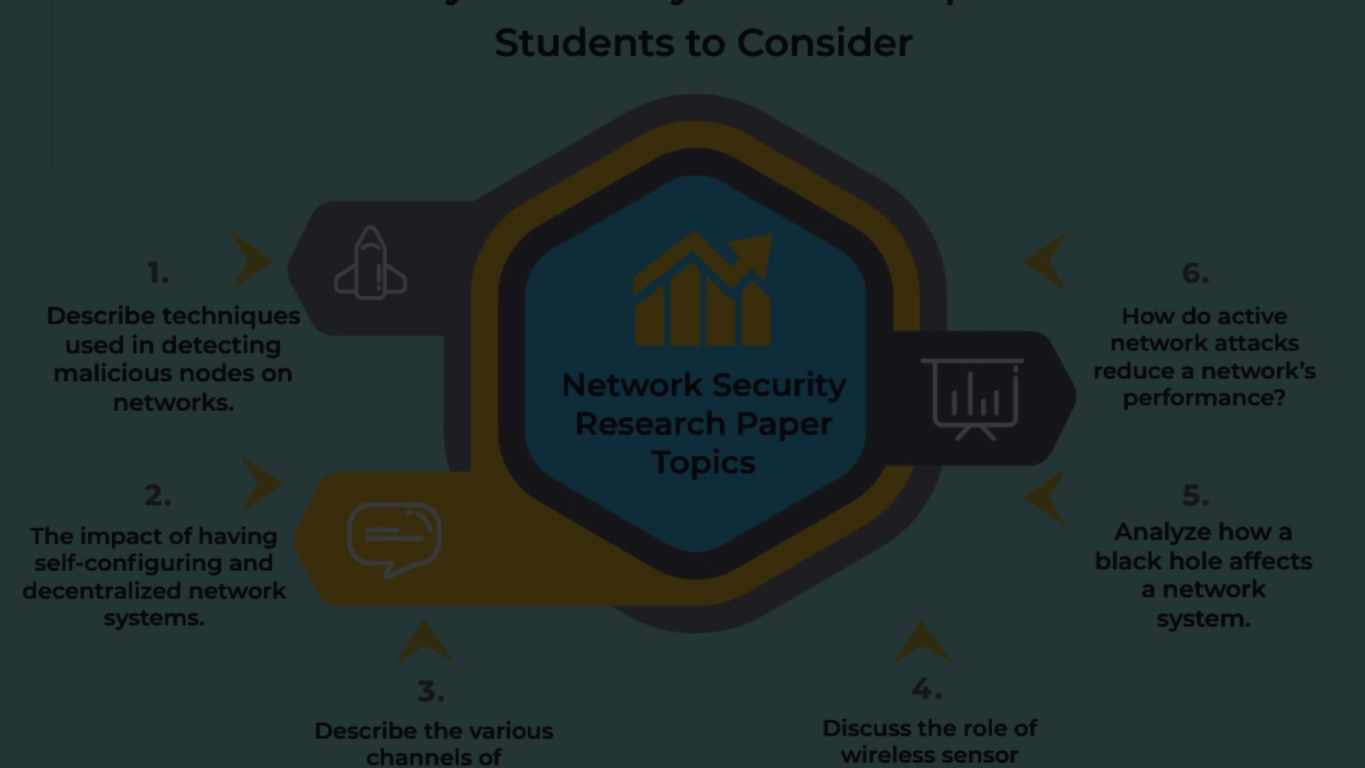
Literature Survey
Research Analysis
In response to this challenge, researchers have explored the use of Artificial Intelligence (AI) and Machine Learning (ML) techniques to detect phishing domains, aiming to develop systems capable of accurately identifying malicious URLs.
There have been studies conducted out many theories and methods have been proposed by various authors to detect phishing URLs, some refered paper are mentioned below :-
Arxiv :- https://arxiv.org/abs/2009.11116
Nih:- https://www.ncbi.nlm.nih.gov/pmc/articles/PMC8504731/
Ieee explorer :- https://www.ncbi.nlm.nih.gov/pmc/articles/PMC8504731/
Insights Gathering
Collecting insights into the current state of the art in machine learning algorithms for cybersecurity and threat detection.

Slide 6
Importance of Detecting Phishing URLs
Cybersecurity Protection
User Trust
Detecting phishing URLs is vital for safeguarding sensitive information, preventing data breaches, and maintaining a secure digital environment.
Recognizing and neutralizing phishing URLs helps build and maintain user trust and prevent users to be victim of phishing attack, essential for healthy online interactions and commerce.

Slide 7



Existing System
Cofense : Formerly known as PhishMe, coffense offers a suite of phishing detection and response solutions. Their platform utilizes machine learning algorithms to analyze email content and identify potential phishing attempts.
OpenPhish: OpenPhish is an open-source project that maintains a database of known phishing websites and URLs. It provides APIs and feeds that organizations can integrate into their security systems to block access to malicious domains.

Slide 8
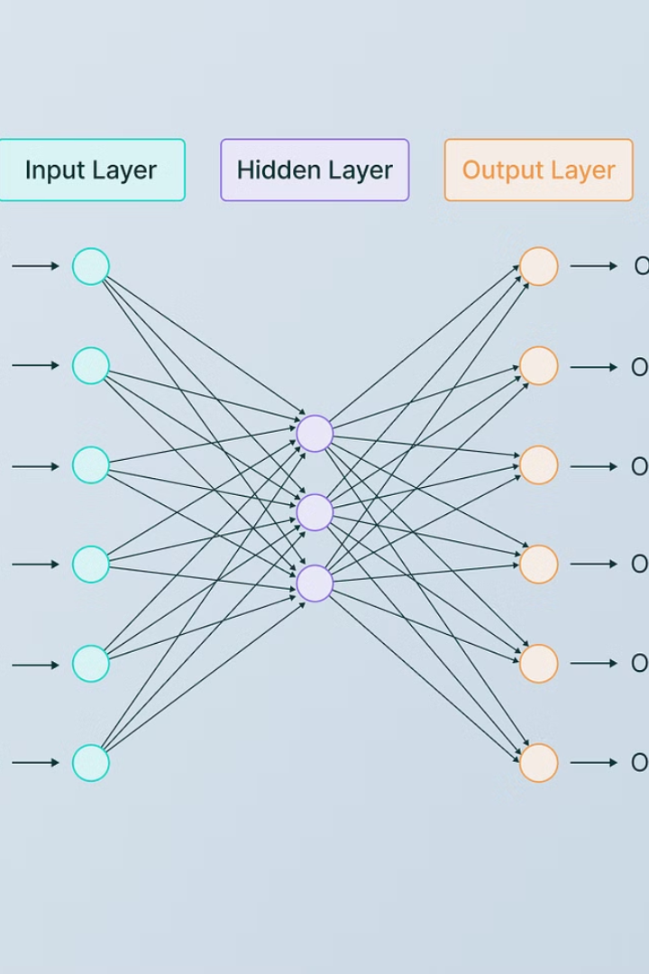
Proposed System
1
Algorithm Development
Designing and implementing machine learning algorithms for efficient and accurate phishing URL detection. (Logistic Regression , XG boost Classifier, and Multi Layer Perceptron etc..)
2
Data Collection
Collecting dataset which contains various feature of URLs to define phishing and Genuine and diverse datasets to train and validate the machine learning models.
3
Evaluation and Testing
Conducting comprehensive testing and evaluation to ensure the system's effectiveness and reliability with the train and test dataset.

Slide 9



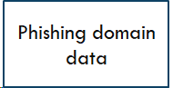
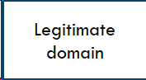
System Architecture

Slide 10





Slide 11







Slide 12
Algorithms
Logistic regression :- Logistic Regression is a binary classification algorithm that models the probability of a binary outcome based on one or more predictor variables.
Multi layer perceptron :-Multi-layer Perceptron is a type of artificial neural network with multiple layers of nodes (neurons), each connected to the next layer.
Gradient boosting :-Gradient Boosting is an ensemble learning technique that builds multiple weak learners (typically decision trees) sequentially, where each tree corrects the errors of the previous one.

Slide 13
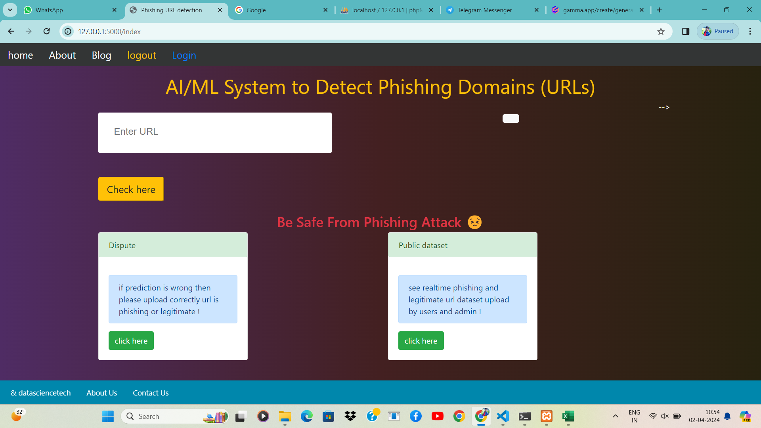
Implementation & Result

Slide 14
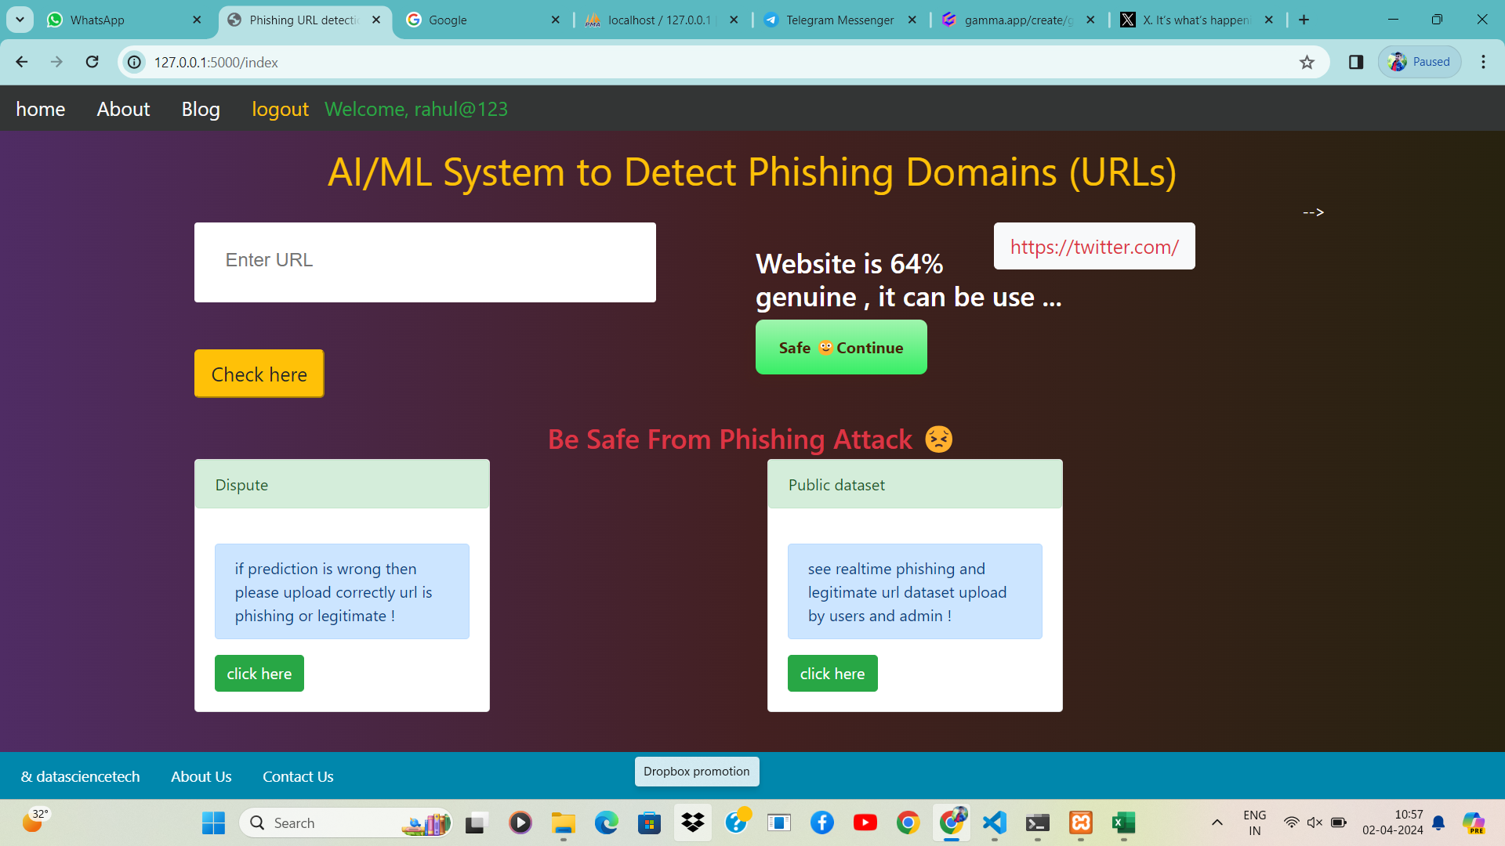
Output

Slide 15
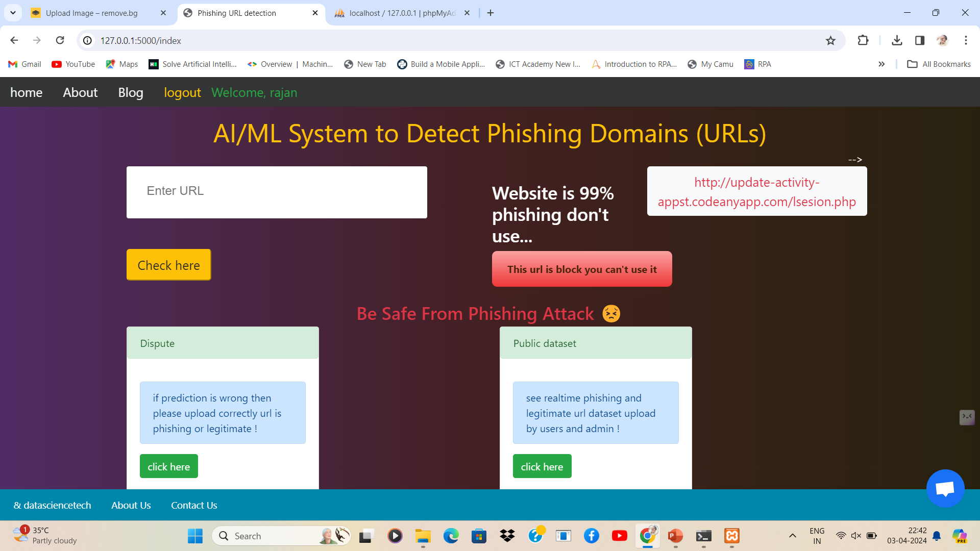

Slide 16



Future Developments and Conclusion
Continuous Improvement
Technological Innovation
Security Enhancement
Developing cutting-edge security measures to counter evolving cyber threats and enhance overall protection.
Constantly updating and refining the system to adapt to emerging phishing attacks and technological advancements.
Exploring innovative technologies to enhance the accuracy and efficiency of phishing URL detection.

Slide 17

Demo

Slide 18
Thank You🙏🙂

